Slide 1
SUMMER MISSION TRIP
Destination:
RAPID CITY, SD
June 26 -July 1

Slide 3
Who Can Go?:
What Grade must they have finished to go?
exiting grade 6-9
Do they have to go to this church?
No, we welcome friends to go. YouthWorks does not require participants to be Lutheran or a specific domination, however a background in some church related topics may help

Slide 4
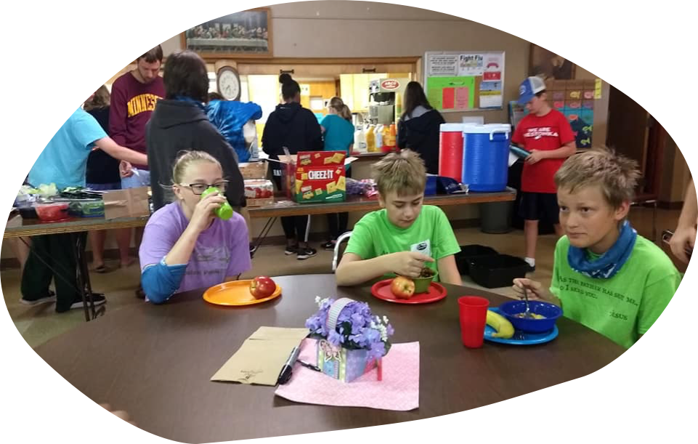
YOUTHWORKS

Slide 5
Youth Work’s Goals
Community Relationships
Age Appropriate Service
Multi-Cultural Learning
Physical Service
Worship

Slide 6
Jesus
Everything we do points to Jesus.
Churches
We want church and youth
leaders to be free to focus on
building relationships.
Multi-Denominational
We approach communities with
humility and a willingness
to partner in the work God is already doing.
Teenagers
We want teenagers to understand
who God is, how God sees them,
and how God may use them to
impact our world.
Multi-
Denominational
We seek to serve every
part of the body of Christ.
Summer Staff
We invest in the next generation of ministry leaders.

Slide 7
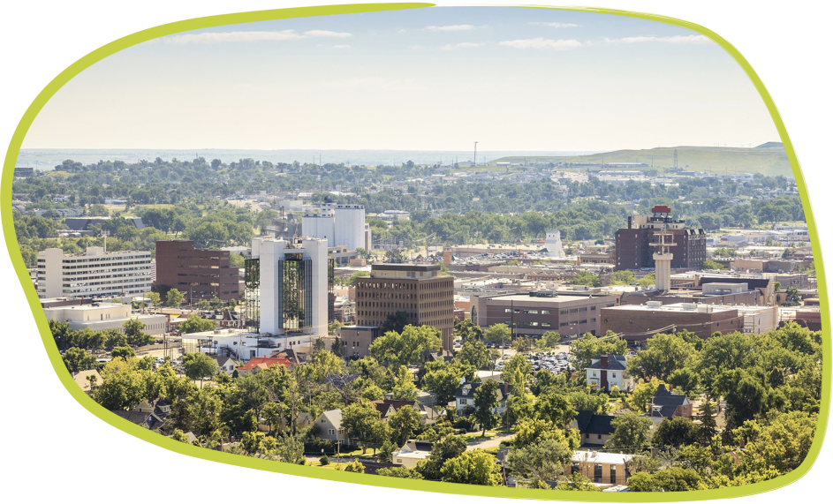
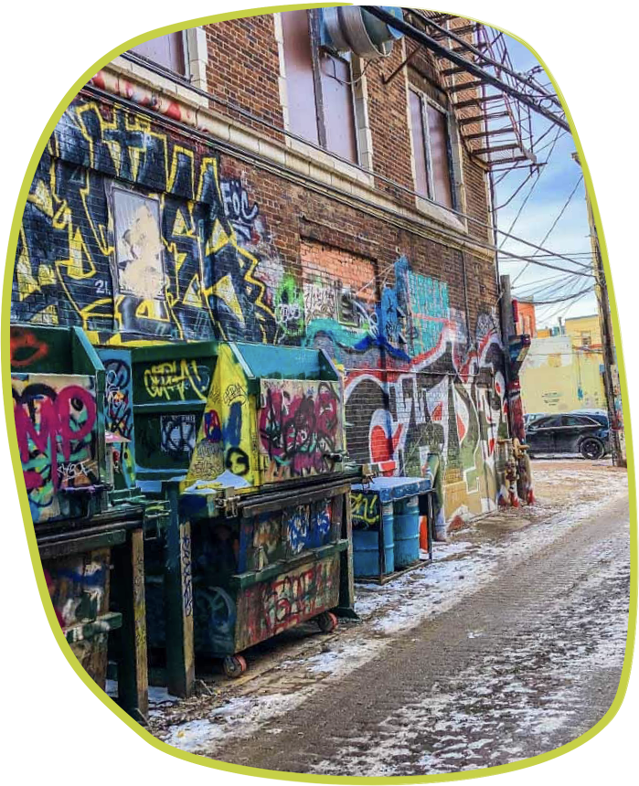
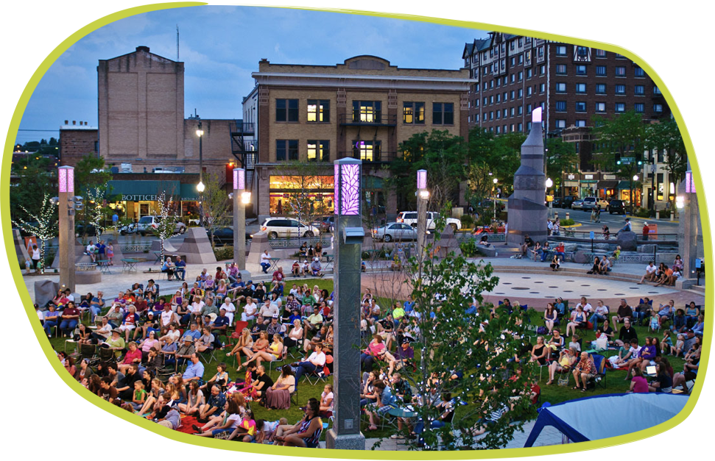

Slide 8
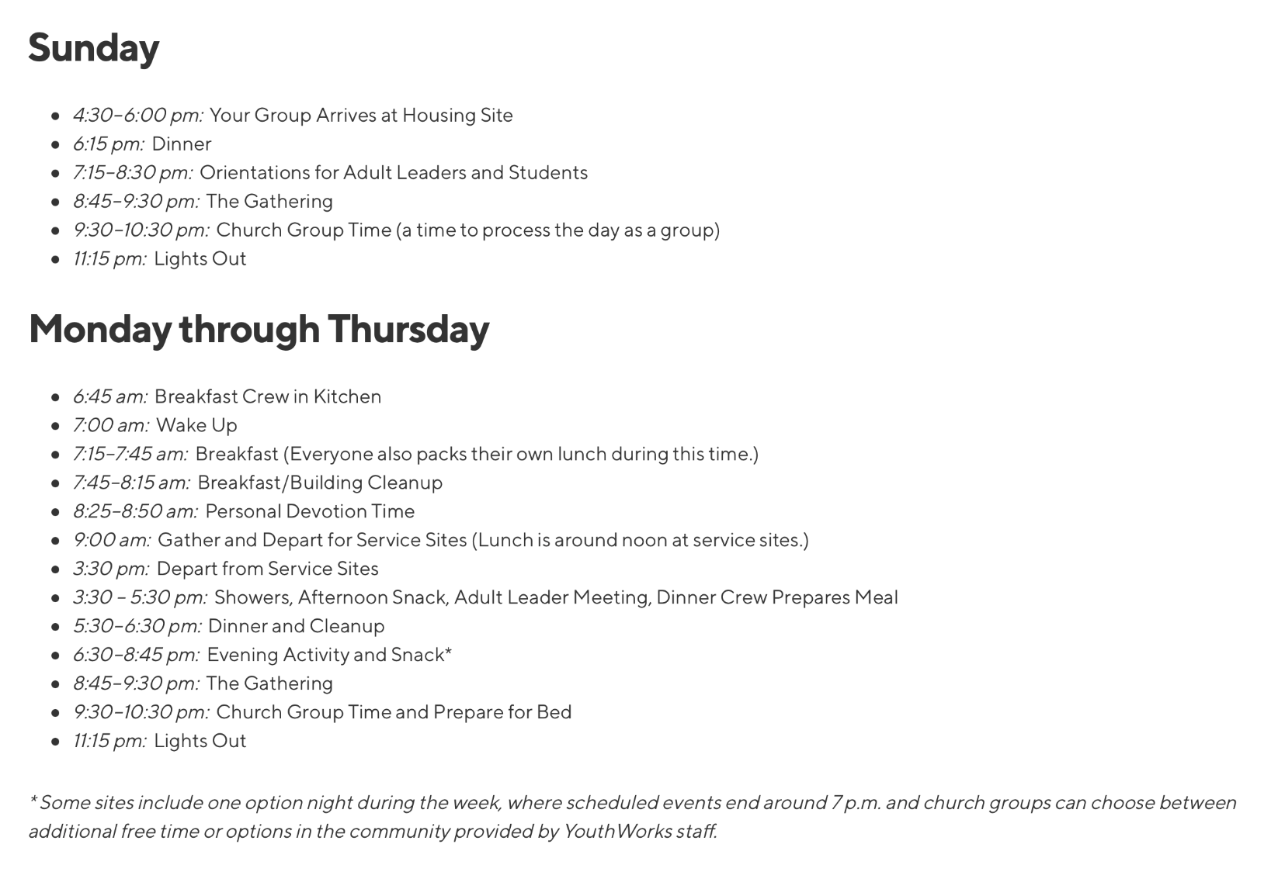
Friday
6:30–7:00 am: Wake Up and Load Vehicles
7:00–9:00 am: Breakfast, Building Cleanup and Send-Off

Slide 9
Traveling and packing
We will be renting 12-15 passenger vans and anticipate having 10-12 people attending this trip.
We will be leaving the church at 7:15am Saturday the 25th.
The weather will most likely be similar to MN in June, so pack for cool-hot weather conditions including rain gear.
For packing, your student is limited to one suitcase. They can have a bag for bedding and a backpack for the van.
Your student will more than likely need a swimsuit on site. Youthworks policy is for one piece suits or a two-piece covered with a dark t-shirt.
We plan to arrive back to Trinity at tbd pm

Slide 10
Keeping In Touch (BOTH )
I will try to implement a live twitter feed on the church’s website. Otherwise there will be a pinned facebook post on our church facebook page and Kristie at Trinity FB page.
You can also visit https://twitter.com/hashtag/TLCSP2022?src=hashtag_click and see all the tweets about the trip. You will want to click on the tab that says “latest”. The hashtag for the trip is #tlcsp2022. Any tweet that has that hashtag will show up on the live feed on the website and the link above.
(SEE TWITTER FEED HANDOUT FOR EXAMPLE)
This feed will include updates, photos and other fun things. This will also be the way that you will know that we have arrived safely at each of our overnight stops.

Slide 11
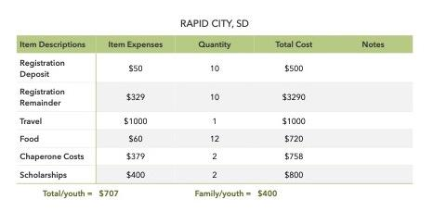

Slide 12
ELCA Youth Gathering
Destination:
Minneapolis, MN
July 24-July 28

Slide 13
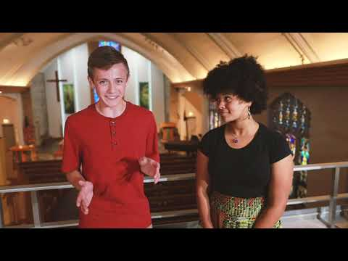

Slide 15
Who Can Go?:
What Grade can go?
8-12
Do they have to go to this church?
For the ELCA Gathering, they do need to be registered under their church because they have congregational registration.

Slide 16
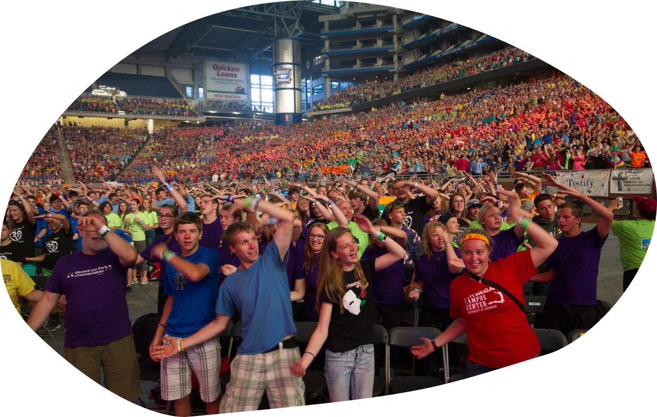
ELCA Youth Gathering

Slide 17
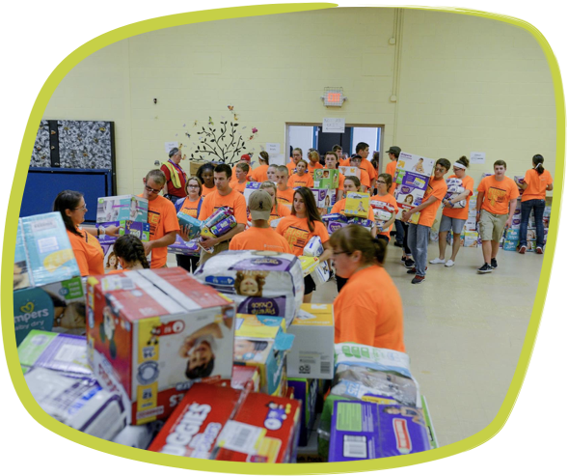
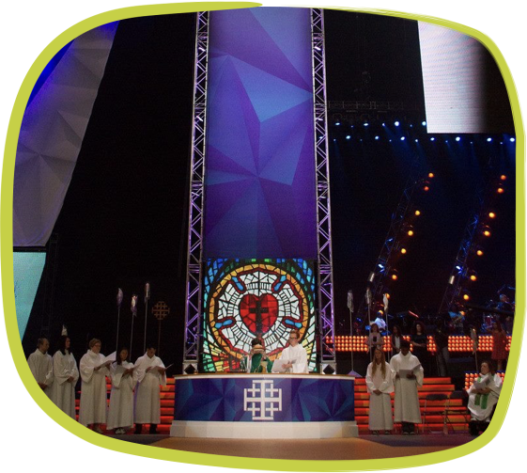
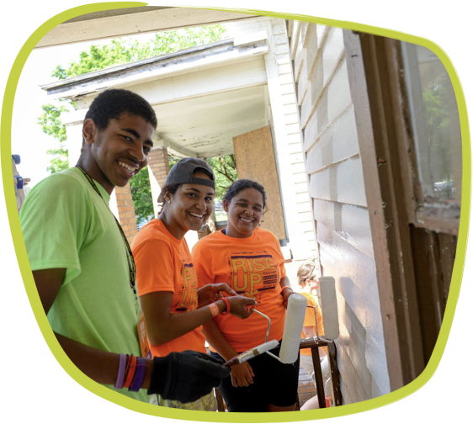

Slide 19
Traveling and packing
We will be leaving the church at a time that correlates with the hotel we will stay in. ELCA gathering has all groups staying in a hotel to keep everyone together.
Since we are 1.5 hr away, we won’t have to leave as early
Pack for all weather scenarios (we are true Minnesotans, you know the drill)
For packing, your student is limited to one suitcase. They can have a bag for bedding and a backpack for the van.
We plan to arrive back to Trinity in the afternoon, more specific times tbd.

Slide 20
Keeping In Touch (BOTH )
I will try to implement a live twitter feed on the church’s website. Otherwise there will be a pinned facebook post on our church facebook page and Kristie at Trinity FB page.
You can also visit https://twitter.com/hashtag/TLCSP2022?src=hashtag_click and see all the tweets about the trip. You will want to click on the tab that says “latest”. The hashtag for the trip is #tlcsp2022. Any tweet that has that hashtag will show up on the live feed on the website and the link above.
(SEE TWITTER FEED HANDOUT FOR EXAMPLE)
This feed will include updates, photos and other fun things. This will also be the way that you will know that we have arrived safely at each of our overnight stops.

Slide 22
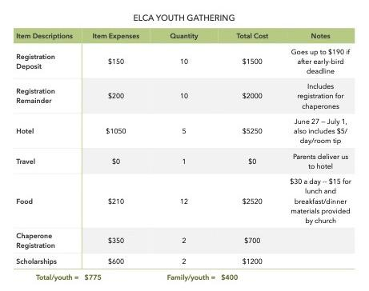

Slide 23
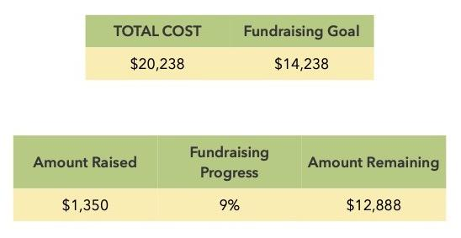

Slide 24
Whats Next
If you are ready to commit to a trip, please sign up as you leave. If you still need to think about it, the due date to decide is in one week so next Sunday 09/26 is when we need to know.
This will allow us time to set up fundraising, our first fundraiser starts SOON.
Parents, please sign up for at least one fundraiser to help run
Next meetings will have more details for each trip (specific travel plans, form information, additional expenses, t-shirt info etc.)

